Slide 1
Project 1
CSR Consulting:
Christian R., Rich K., Stefany L
Notes:
Title Slide
Include the name of the Project and Group Members

Slide 2
Summary & Motivation

Slide 3

Summary
Initial Questions
Hypothesis: Vernon Hills, IL has the potential to host a new high-end restaurant, using data insights to understand competition and underserved market segments.
We are targeting our presentation on opening a restaurant in Vernon Hills. Using different datasets from Yelp and Census data to decide where to open, type of restaurant, hours of operation, and the competitive landscape.
Our project is to uncover patterns and competitive landscaping in order to determine critical early decisions such as where to establish their business, the competitive landscape to identify underserved market segments, and other data driven insights.
Where will restaurant be located?
What type of restaurant?
What expense level to target?
What are best hours of operation of our restaurant?
Notes:
Motivation & Summary Slide
Define the core message or hypothesis of your project.
Describe the questions you asked, and why you asked them
Describe whether you were able to answer these questions to your satisfaction, and briefly summarize your findings
We decided to explore the possibility of opening a restaurant in the Chicago northwest suburban area. Vernon Hills was selected because it is a busy suburban location and team members are familiar with the location. We decided to use the Yelp API and U.S Census data to analyze the restaurants already located within the Vernon Hills geographical area. Usindg the

Slide 4
How to answer our Questions?
Where will the restaurant be located
Vernon Hills, IL
Type of restaurant
Filter by price range, food category
Expense level to target
Identify household income
What are best hours of operation
Identify opportunity, pickup/delivery capable
Notes:
Questions & Data
Elaborate on the questions you asked, describing what kinds of data you needed to answer them, and where you found it

Slide 5
Data Cleanup & Exploration
Notes:
Data Cleanup & Exploration
Describe the exploration and cleanup process
Discuss insights you had while exploring the data that you didn't anticipate
Discuss any problems that arose after exploring the data, and how you resolved them
Present and discuss interesting figures developed during exploration, ideally with the help of Jupyter Notebook

Slide 6

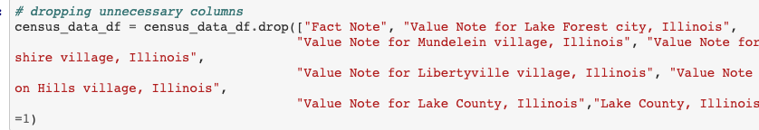
Data Cleaning Process
Massive amounts of data available but not relevant
Dropped unnecessary columns in CSV
Notes:
Example: Census data

Slide 7
Data Analysis
Notes:
Data Analysis
Discuss the steps you took to analyze the data and answer each question you asked in your proposal
Present and discuss interesting figures developed during analysis, ideally with the help of Jupyter Notebook

Slide 8


Data Sources
Yelp API
Search by location radius (Vernon Hills City Hall)
Filter for name, categories, price range ($), hours, location (latitude/longitude), # of reviews, and ratings
US Census Bureau
Find household income, amount of households,
broadband
Notes:
Vernon Hills City Hall chosen as the reference point for location.

Slide 9
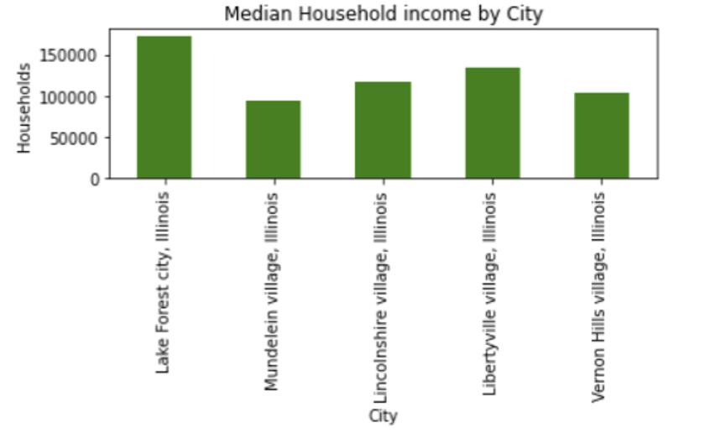
Vernon Hills Median Income
Source: US Census
Notes:
Rationale:
Price is one of the first things considered when making any purchase. To give a percentage of

Slide 10
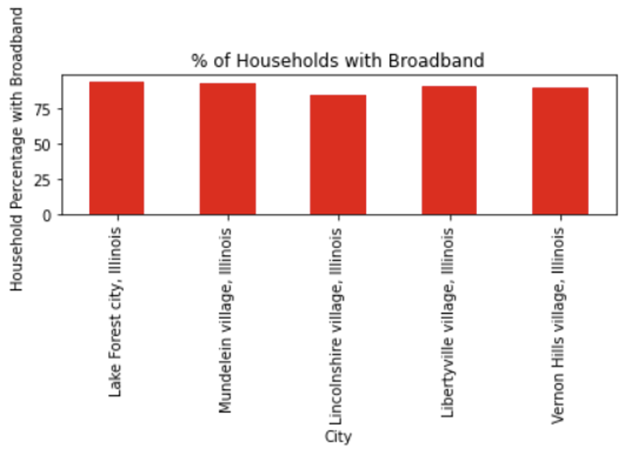
Percentage of Households with Broadband
Source: US Census
Notes:
Rationale:
We know people often look up reviews for restaurants before they visit. Due to COVID-19 and other factors, people may continue to purchase food only from those restaurants offering pickup and delivery. This shows that Vernon Hills has

Slide 11
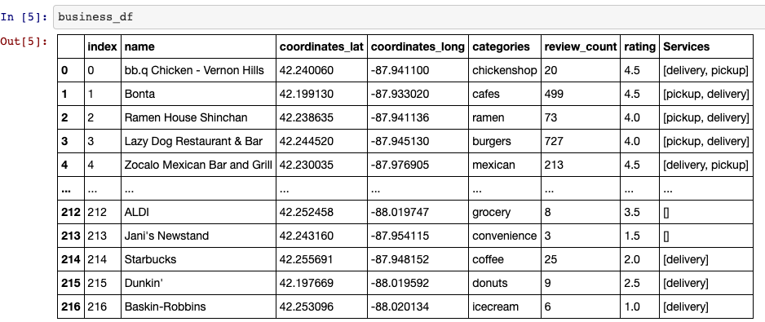
Data Analysis
Pulled Yelp business IDs within radius to CSV file
Looped through CSV business IDs
Business IDs used to extract info
Census data used to support location

Slide 12
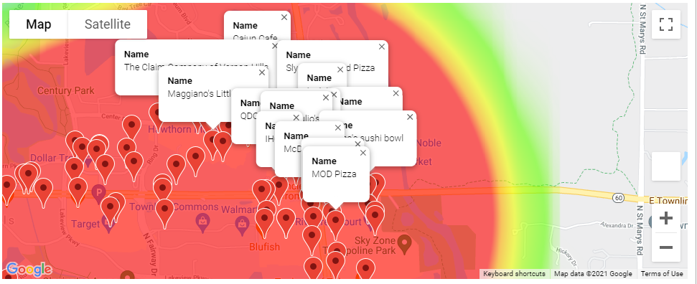
Heatmap based on average ratings and pins with restaurant names
Average rating in response to the Vernon Hills City Hall.
Notes:
Using Google maps, generated a heatmap to identify the popular restaurants.
Color based on average ratings (red to yellow to green) the closer to the epicenter (Vernon Hills City Hall)

Slide 13
Discussion
Notes:
Discussion
Discuss your findings. Did you find what you expected to find? If not, why not? What inferences or general conclusions can you draw from your analysis?

Slide 14
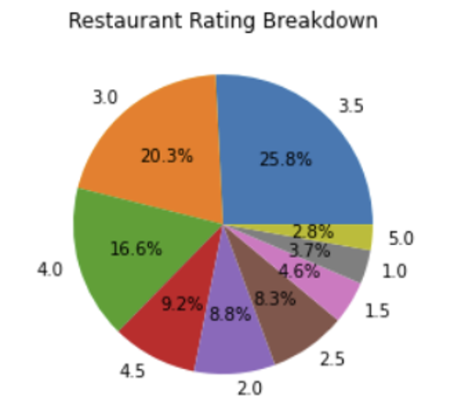
Percentage of Restaurants with Rating
Notes:
Pie chart shows our competition in the area based on ratings and the amount of each identified in Yelp.
About 20.3% of the restaurants rated 3.0 stars
About 25.8% of the restaurants rated 3.5.

Slide 15
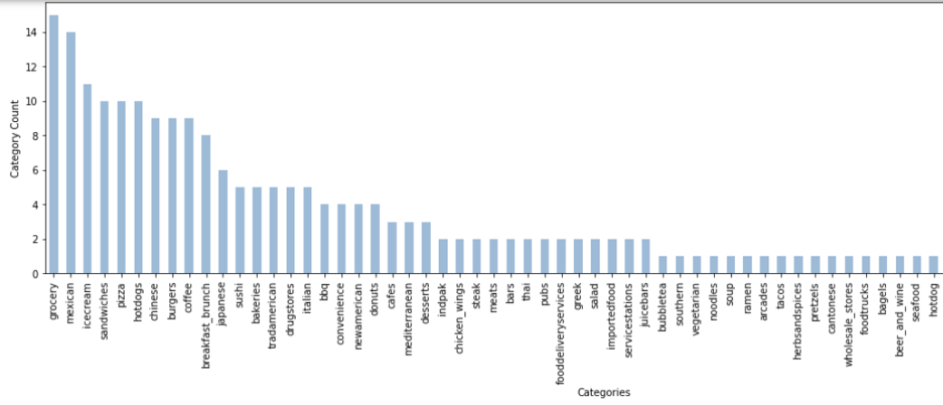
Amount of Restaurants with Categories
Notes:
Bar chart shows the underserved market and gaps available in the area.
For example, if you want to establish a steak or sushi place, there will be less competition than establishing a Mexican restaurant.

Slide 16
Issues & Limitations
Notes:
Post Mortem
Discuss any difficulties that arose, and how you dealt with them
Discuss any additional questions that came up, but which you didn't have time to answer: What would you research next, if you had two more weeks?

Slide 17
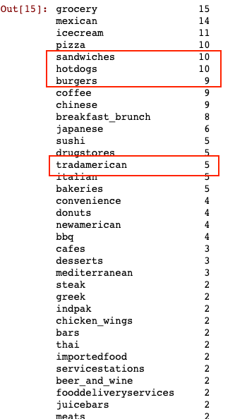
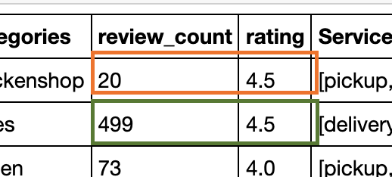

Limitations
Yelp categories are redundant and may have some overlap
Businesses may not have a Yelp profile
# of reviews received vs rating
Price ($$$) did not pull for many
Did not have time to dig deeper into age groups or race
Would like to develop business tool for investors
Notes:
We would have liked to research the price range and how it related to category, especially see it in a chart. However, the API pulled overlapping categories and we could not get the price. The ratings and the amount of reviews received are also not absolute or clear indicators of preference.

Slide 18

Thanks!
Any Questions?
Notes:
Questions
Open-floor Q&A with the audience

Slide 19
Works Cited
United States Census Bureau. (2019). United States QuickFacts. https://www.census.gov/quickfacts/fact/table/US/PST045219
Yelp Fusion API. (2020). Yelp Fusion. https://www.yelp.com/developers/documentation/v3/business
Reed, Alex [Sigma Coding. (2018, December 30). Working With The Yelp API In Python | Part One [Video]. YouTube. https://www.youtube.com/watch?v=GJf7ccRIK4U

